Slide 1
Hospital Management System(HMS)
A Project By : Mst Hajera Begum Shimla
Id: 0562220005101044
And
Suborna Jahan Shumona
Id: 0562320005101203

Slide 2
Hospital Management System
This project is a web-based Hospital Management System that simplifies and automates tasks like doctor registration, appointment booking, and department-wise doctor management.

Slide 3
Project Idea Summary
The system automates:
Patient registration and appointment booking
Doctor onboarding and dashboard access
Admin management and doctor supervision

Slide 4
User Panel – Features
Register, login, and logout
Book appointments with doctors
Browse doctors by specialization
Access department-wise services

Slide 5
Department System
Predefined departments:
Neurology, Cardiology, Pediatrics, etc.
Each department page shows only relevant doctors

Slide 6
Doctor Panel – Features
Login via email
Fill in Add Doctor form
View own data in doctor dashboard

Slide 7
Admin Panel – Features
Register and login as admin
Manage doctor records
View contact messages
See list of other admins

Slide 8
Tools – Frontend
HTML5 & CSS3
JavaScript
Font Awesome Icons
SweetAlert2 for alerts

Slide 9
Tools – Backend & DB
PHP (Core PHP)
MySQL for database
Cookie-based login session management

Slide 10

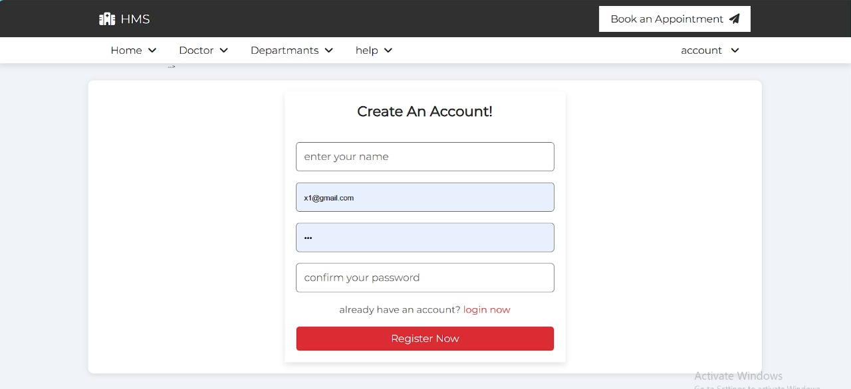
Images of:
Homepage navigation:
Patient register/login page:

Slide 11
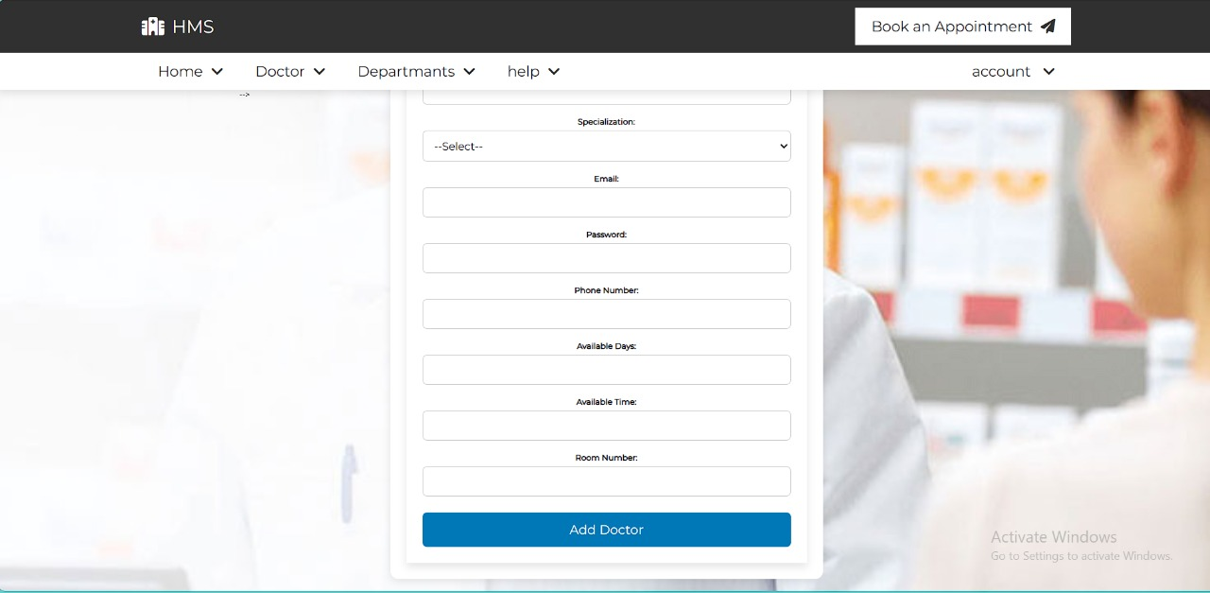
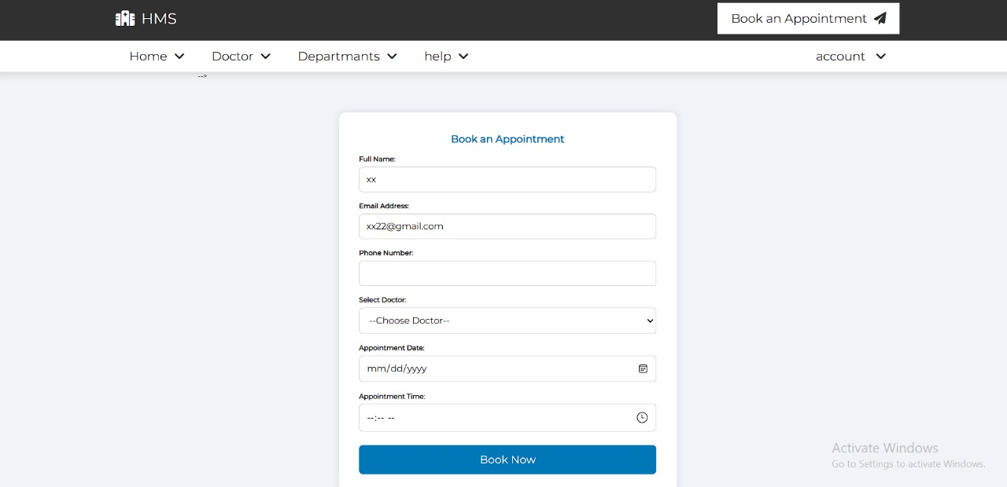
Images of:
Add Doctors Form:
Book Appointment:

Slide 12
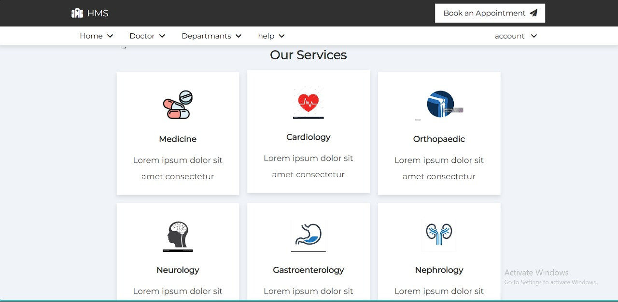
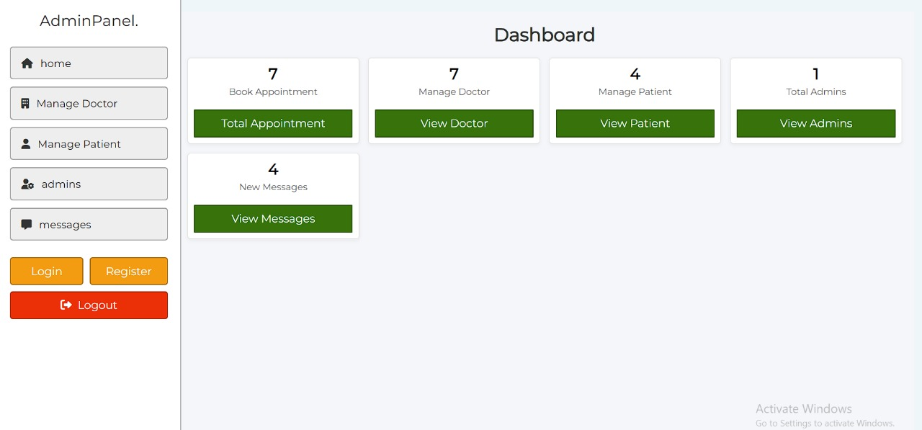
Images Of:
View Doctors by Department:
Admin Dashboard:

Slide 13
Challenges Faced
Role conflict with same email for doctor & patient
Login redirection based on role
Preventing duplicate email registration
Filtering doctors department-wise
Displaying uploaded doctor photos
Maintaining database relationships properly

Slide 14
What I Learned
Role-based login logic
Using cookies for authentication
SQL joins to fetch related user & doctor data
Managing form validation and sanitization
Structuring files and components properly
Enhancing UI using CSS and alert libraries

Slide 15
Thank You!
Thank you for your Attention!
This project gave me hands-on experience in full-stack web development.

